Slide 1

Listening Strategies

Slide 2
Test Sections
There are 4 parts or sections to the IELTS Listening test. Each section is based on one “audio story”. Each section will also contain 10 questions. The total number of questions = 40.
Section 1 – A conversation between two people set in an everyday social context (e.g. booking tickets to the theatre).
Section 2 – A monologue set in an everyday social context (e.g. a welcome talk for new college students).
Section 3 – A conversation between up to four people set in an educational or training context (e.g. a group of students discussing a university assignment).
Section 4 – A monologue on an academic subject (e.g. a lecture on wildlife).
Section | Level of Difficulty | Interaction Pattern | Subject/ Topic
1 | Easy | Dialogue | Any
2 | Slightly harder | Dialogue/Monologue
3 | Hard | Dialogue/Monologue
4 | Even harder | Dialogue/Monologue

Slide 3

Listening Strategies
Question Analysis Answer Prediction Keyword Clues

Slide 4
Question Analysis
The listening test contains four recordings. Before listening to each of them you will be given time (around 20-35 seconds) to read the questions they relate to.
Use this time well. It might not sound very long but it’s long enough to do the important preparation work that will enable you to complete the questions successfully.
When analysing the questions, there are 3 key things to note:
 | a) Which section of the test are they in? b) What type of questions are they? c) What sort of information do you need to listen for?

Slide 5
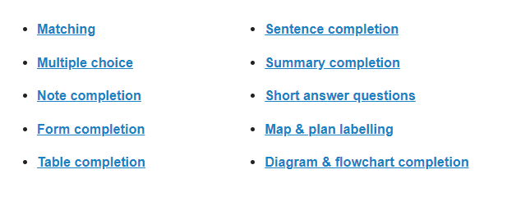
Question Types

Slide 6
Answer Prediction
To predict an answer is to say what type of word you think it will be based on the evidence you have. That evidence will be in the question clues we’ve just been talking about and the information in the questions.
Here are some things you may be able to predict:
 | The type of information required, e.g. name, date, phone number, percentage, price, place name. The type of word required, e.g. noun, adjective, verb. Synonyms or paraphrasing that might be used, e.g. ‘a half’ for ‘50%’, ‘located in the countryside’ for ‘is in a rural area’.

Slide 7
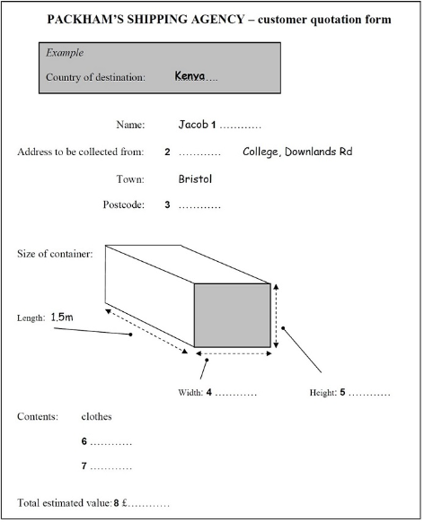
These are the answer predictions we can make:
1 – a surname
2 – the college name
3 – a postcode made up of letters and numbers
4 & 5 – numbers of measurement
6 & 7 – nouns (items in the box)
8 – numbers written as a price

Slide 8
Keyword Clues
Item number three in our list of IELTS listening strategies is also to do with prediction but particularly relevant for questions containing a lot of text as opposed to a diagram, map, plan or table.
The technique is to identify the keywords or phrases in the question. Why? Because the answers will very likely be synonyms or paraphrasing of these.

Slide 9
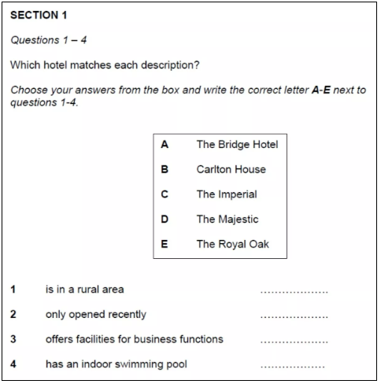
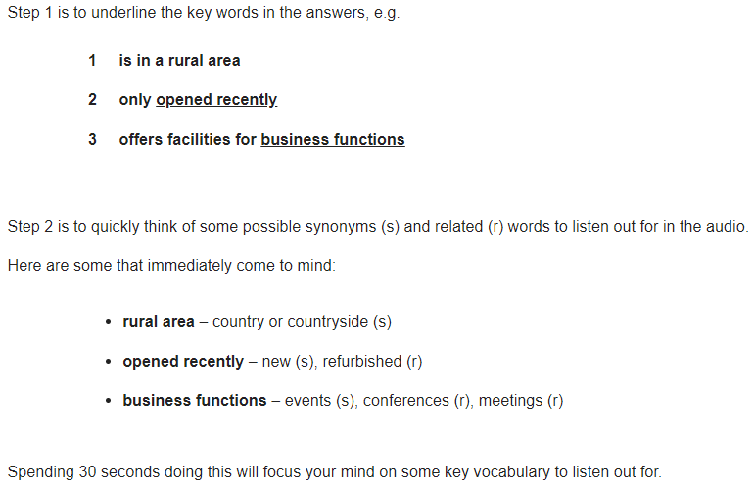

Slide 10
If you want something with a bit of character, Carlton House is quite unusual – it's a very old building that was originally a large private house. It was bought by the Vannis chain and they completely refurbished it – they took their first guests just a few months ago but it's already got an excellent reputation. That's a five star hotel. Or there's the Imperial, which is a much more modern building. That also has its own gym and it has internet connection and meetings rooms – it's used for conferences and corporate events as well as private guests. That's five star as well.

